Slide 1
Session 2020-21 CSTE-3101 Communication Engineering

Slide 2
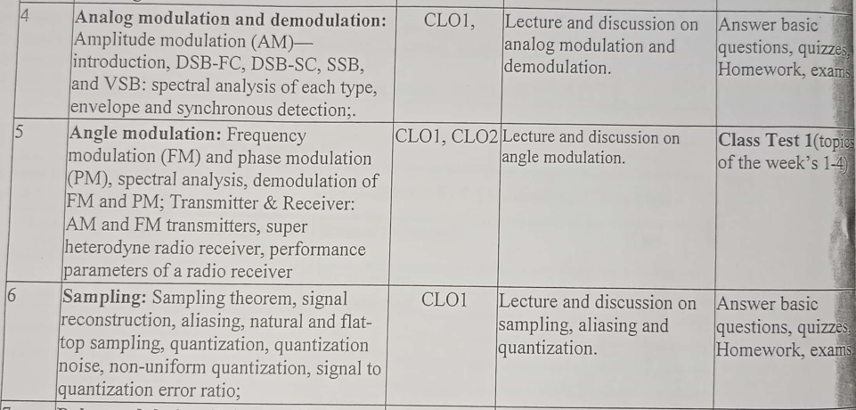
Week: 4-8

Slide 3
Book Reference
Modern digital and analog communication: B. P Lathi
Communication systems by Simon S. Haykin
Communication systems: Analog and Digital by Sanjay Sharma
Data Communications and Networking by Behrouz A. Forouzan, McGraw-Hill.

Slide 4
Types of modulation

Slide 5
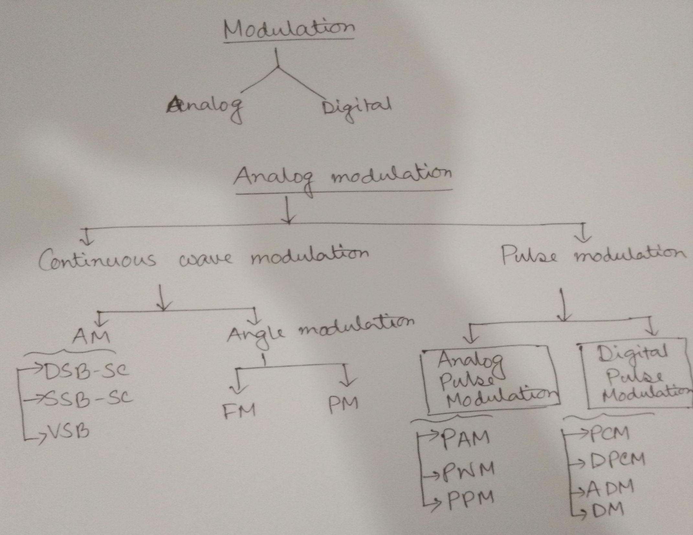

Slide 6
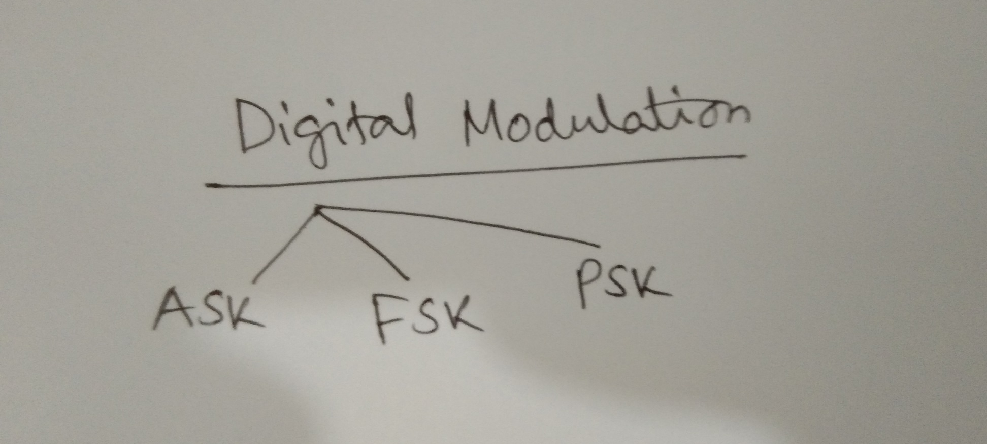

Slide 7
Basic Modulation

Slide 8
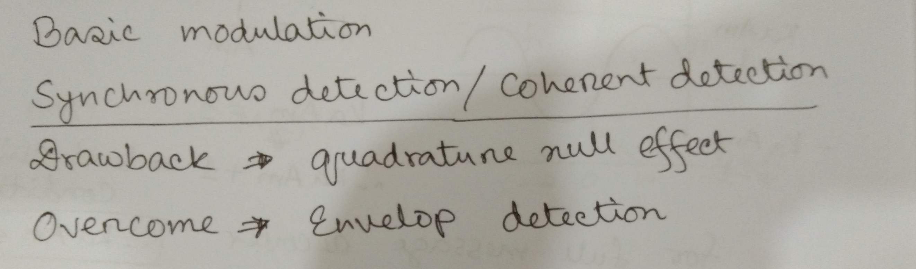

Slide 9
Amplitude Modulation
(Double Side Band- Full Carrier AM (DSB-FC))

Slide 10
When Baseband Signal have multiple frequencies

Slide 11
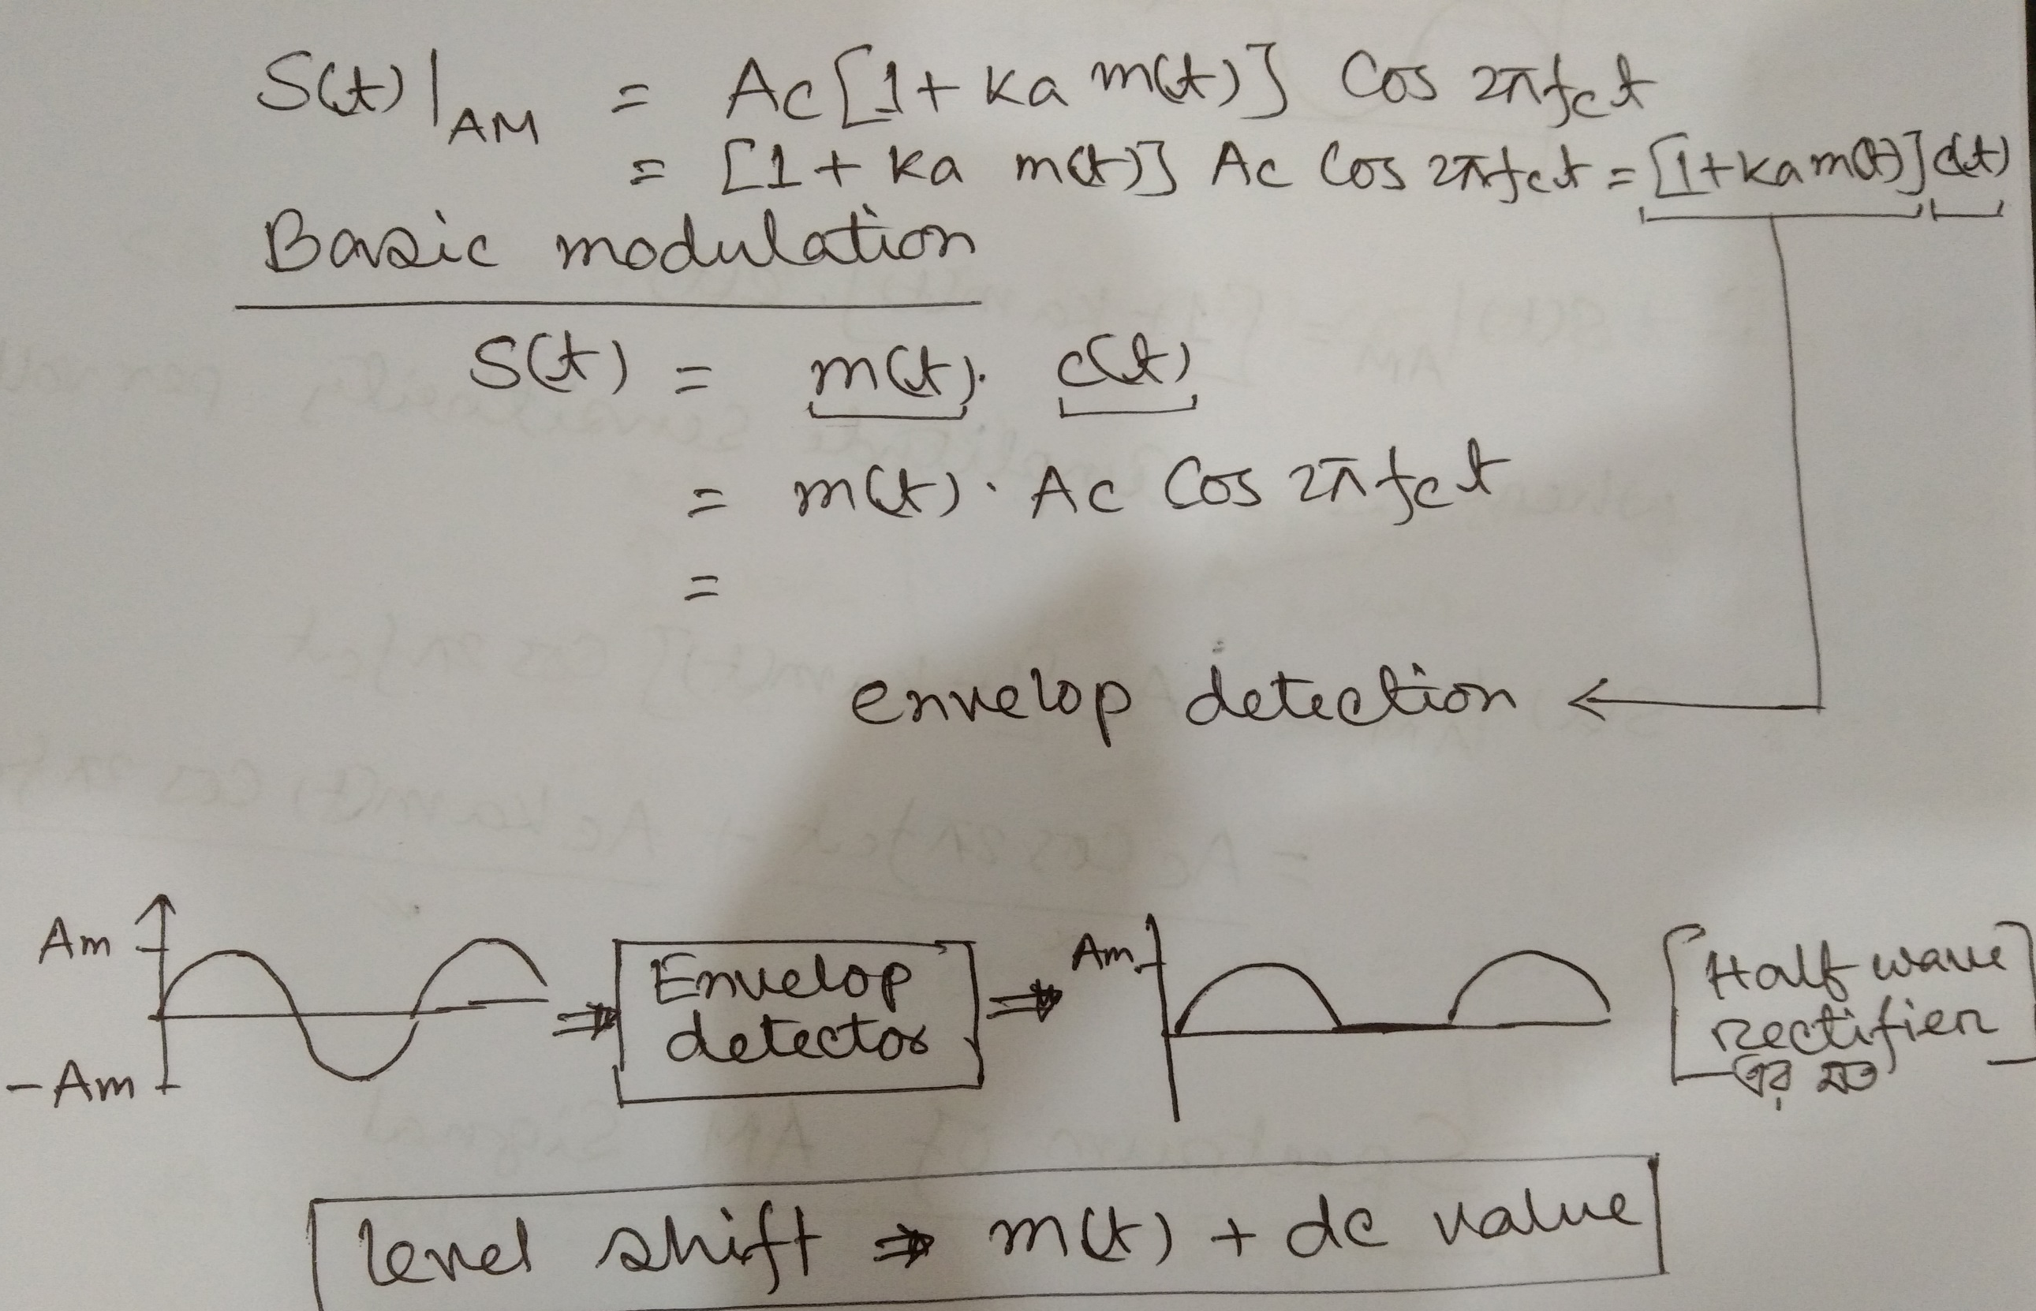

Slide 12
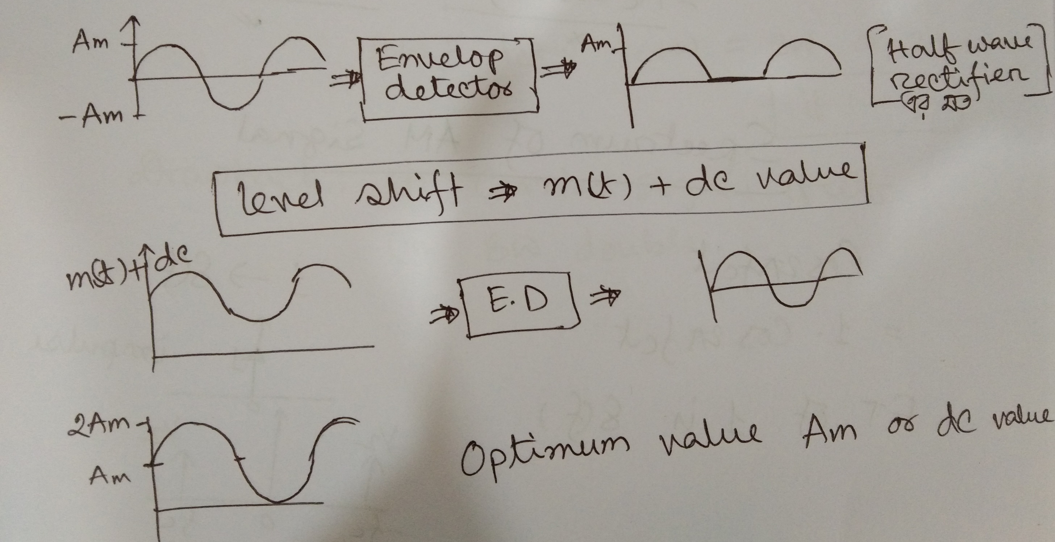

Slide 13
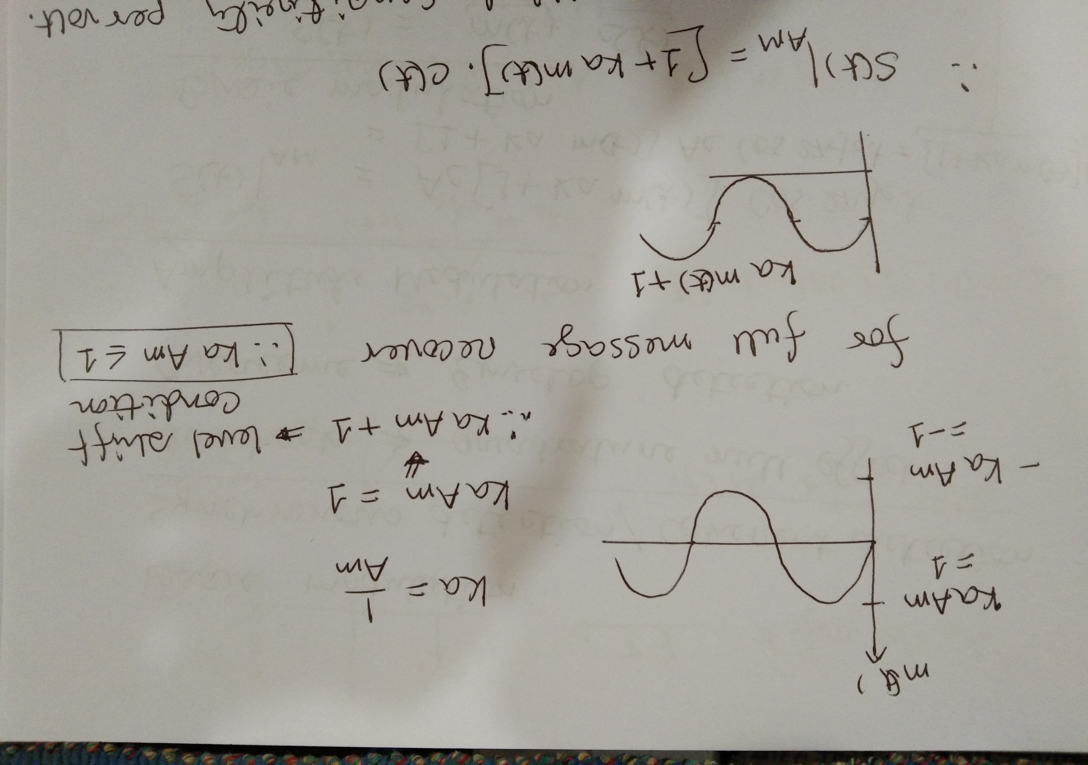
see

Slide 14
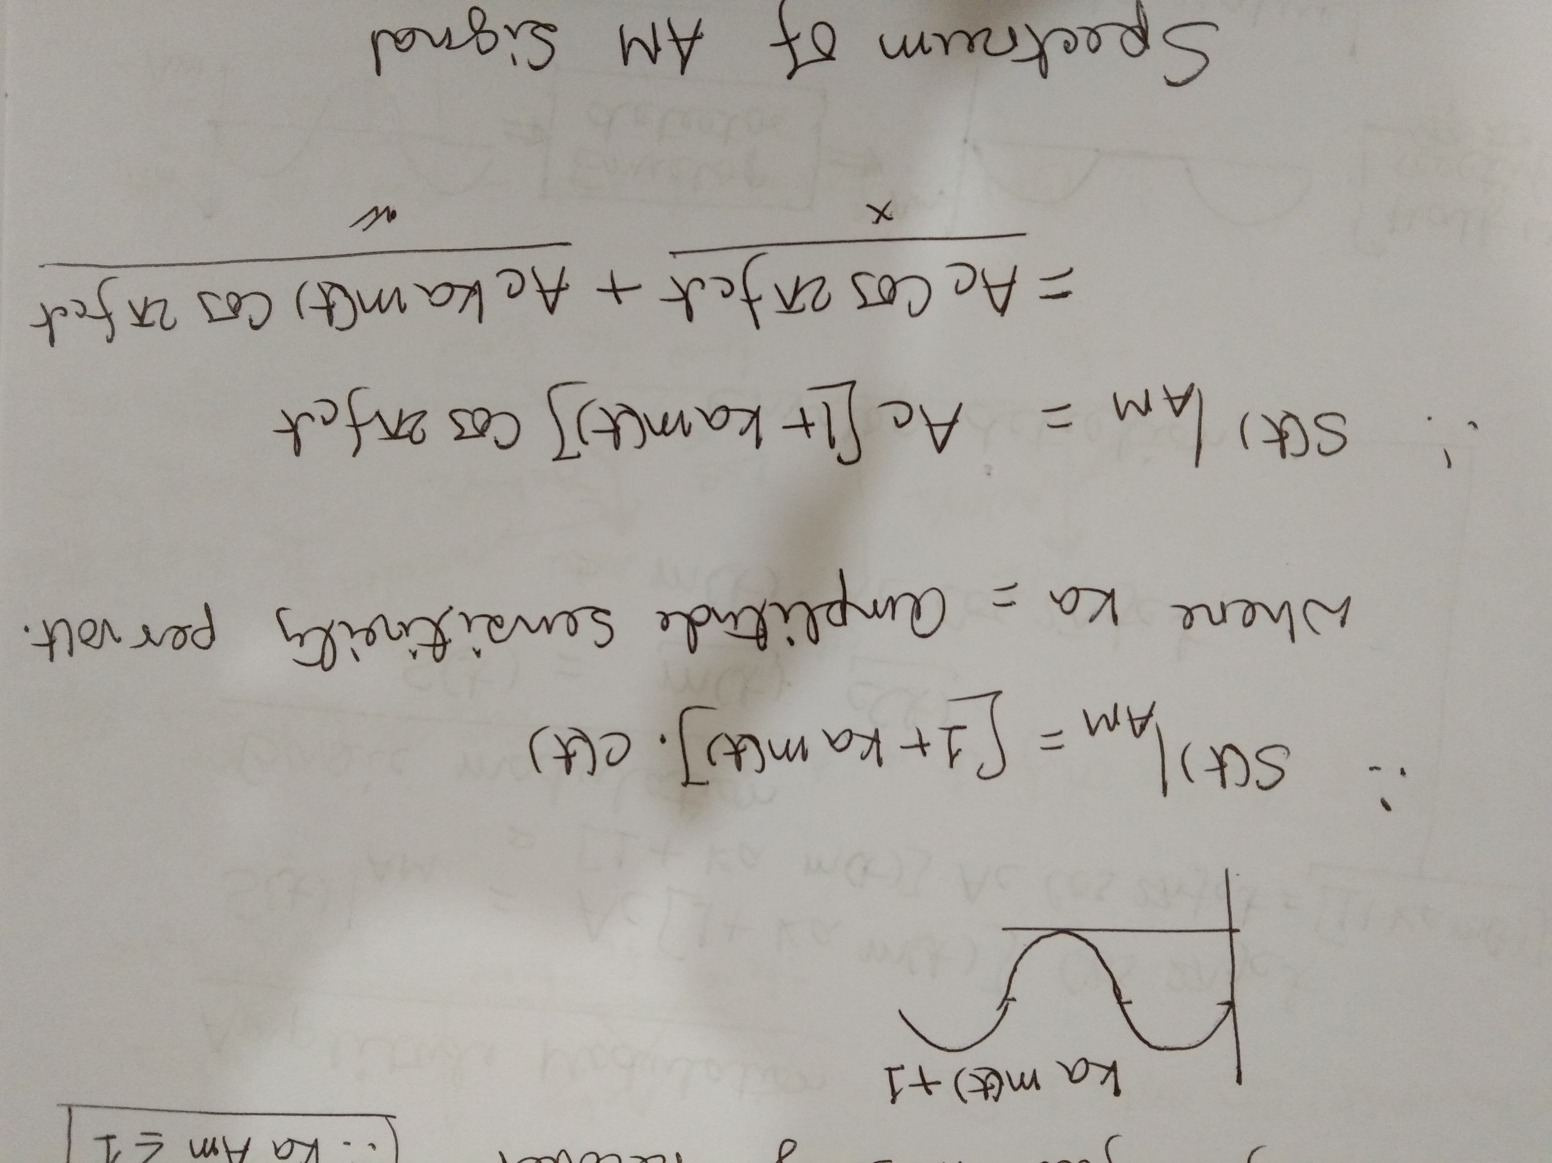

Slide 15
Spectrum of AM signal
(When Baseband Signal have multiple frequencies)

Slide 16
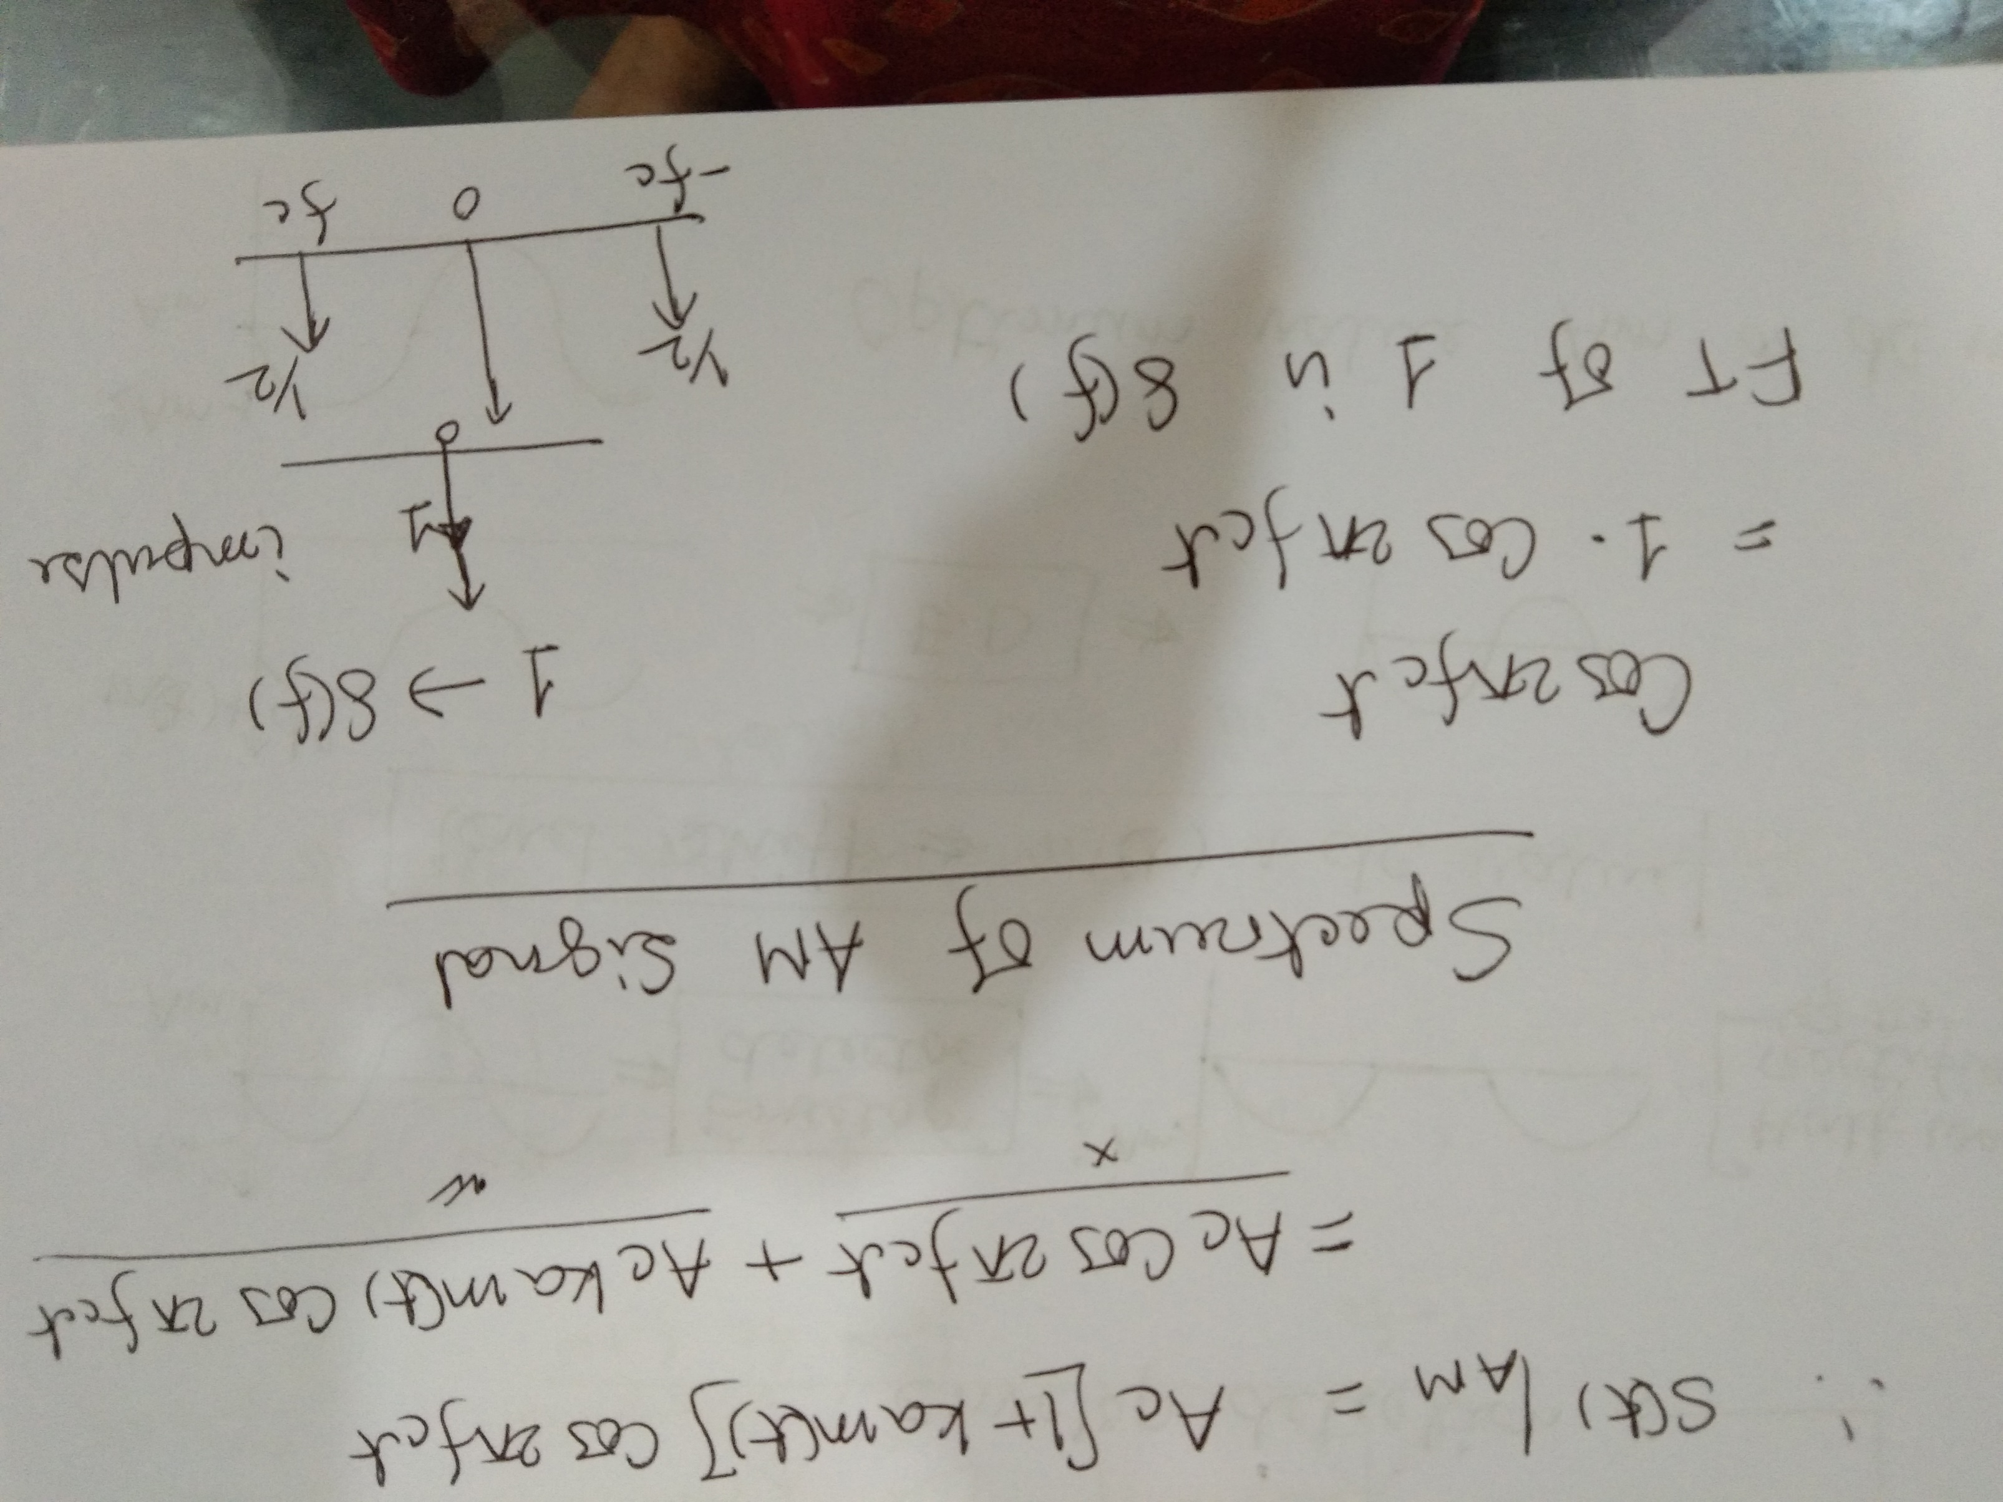

Slide 17
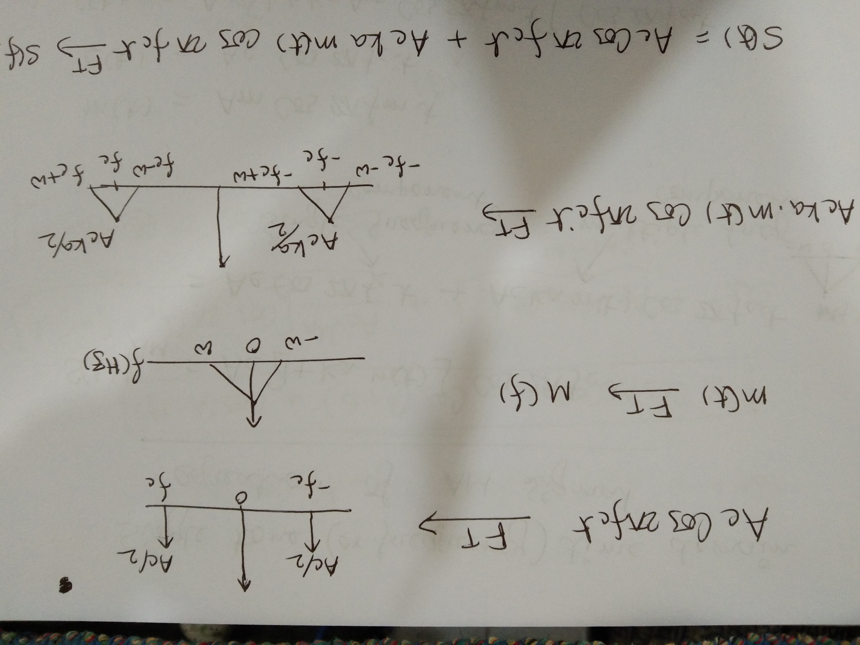

Slide 18
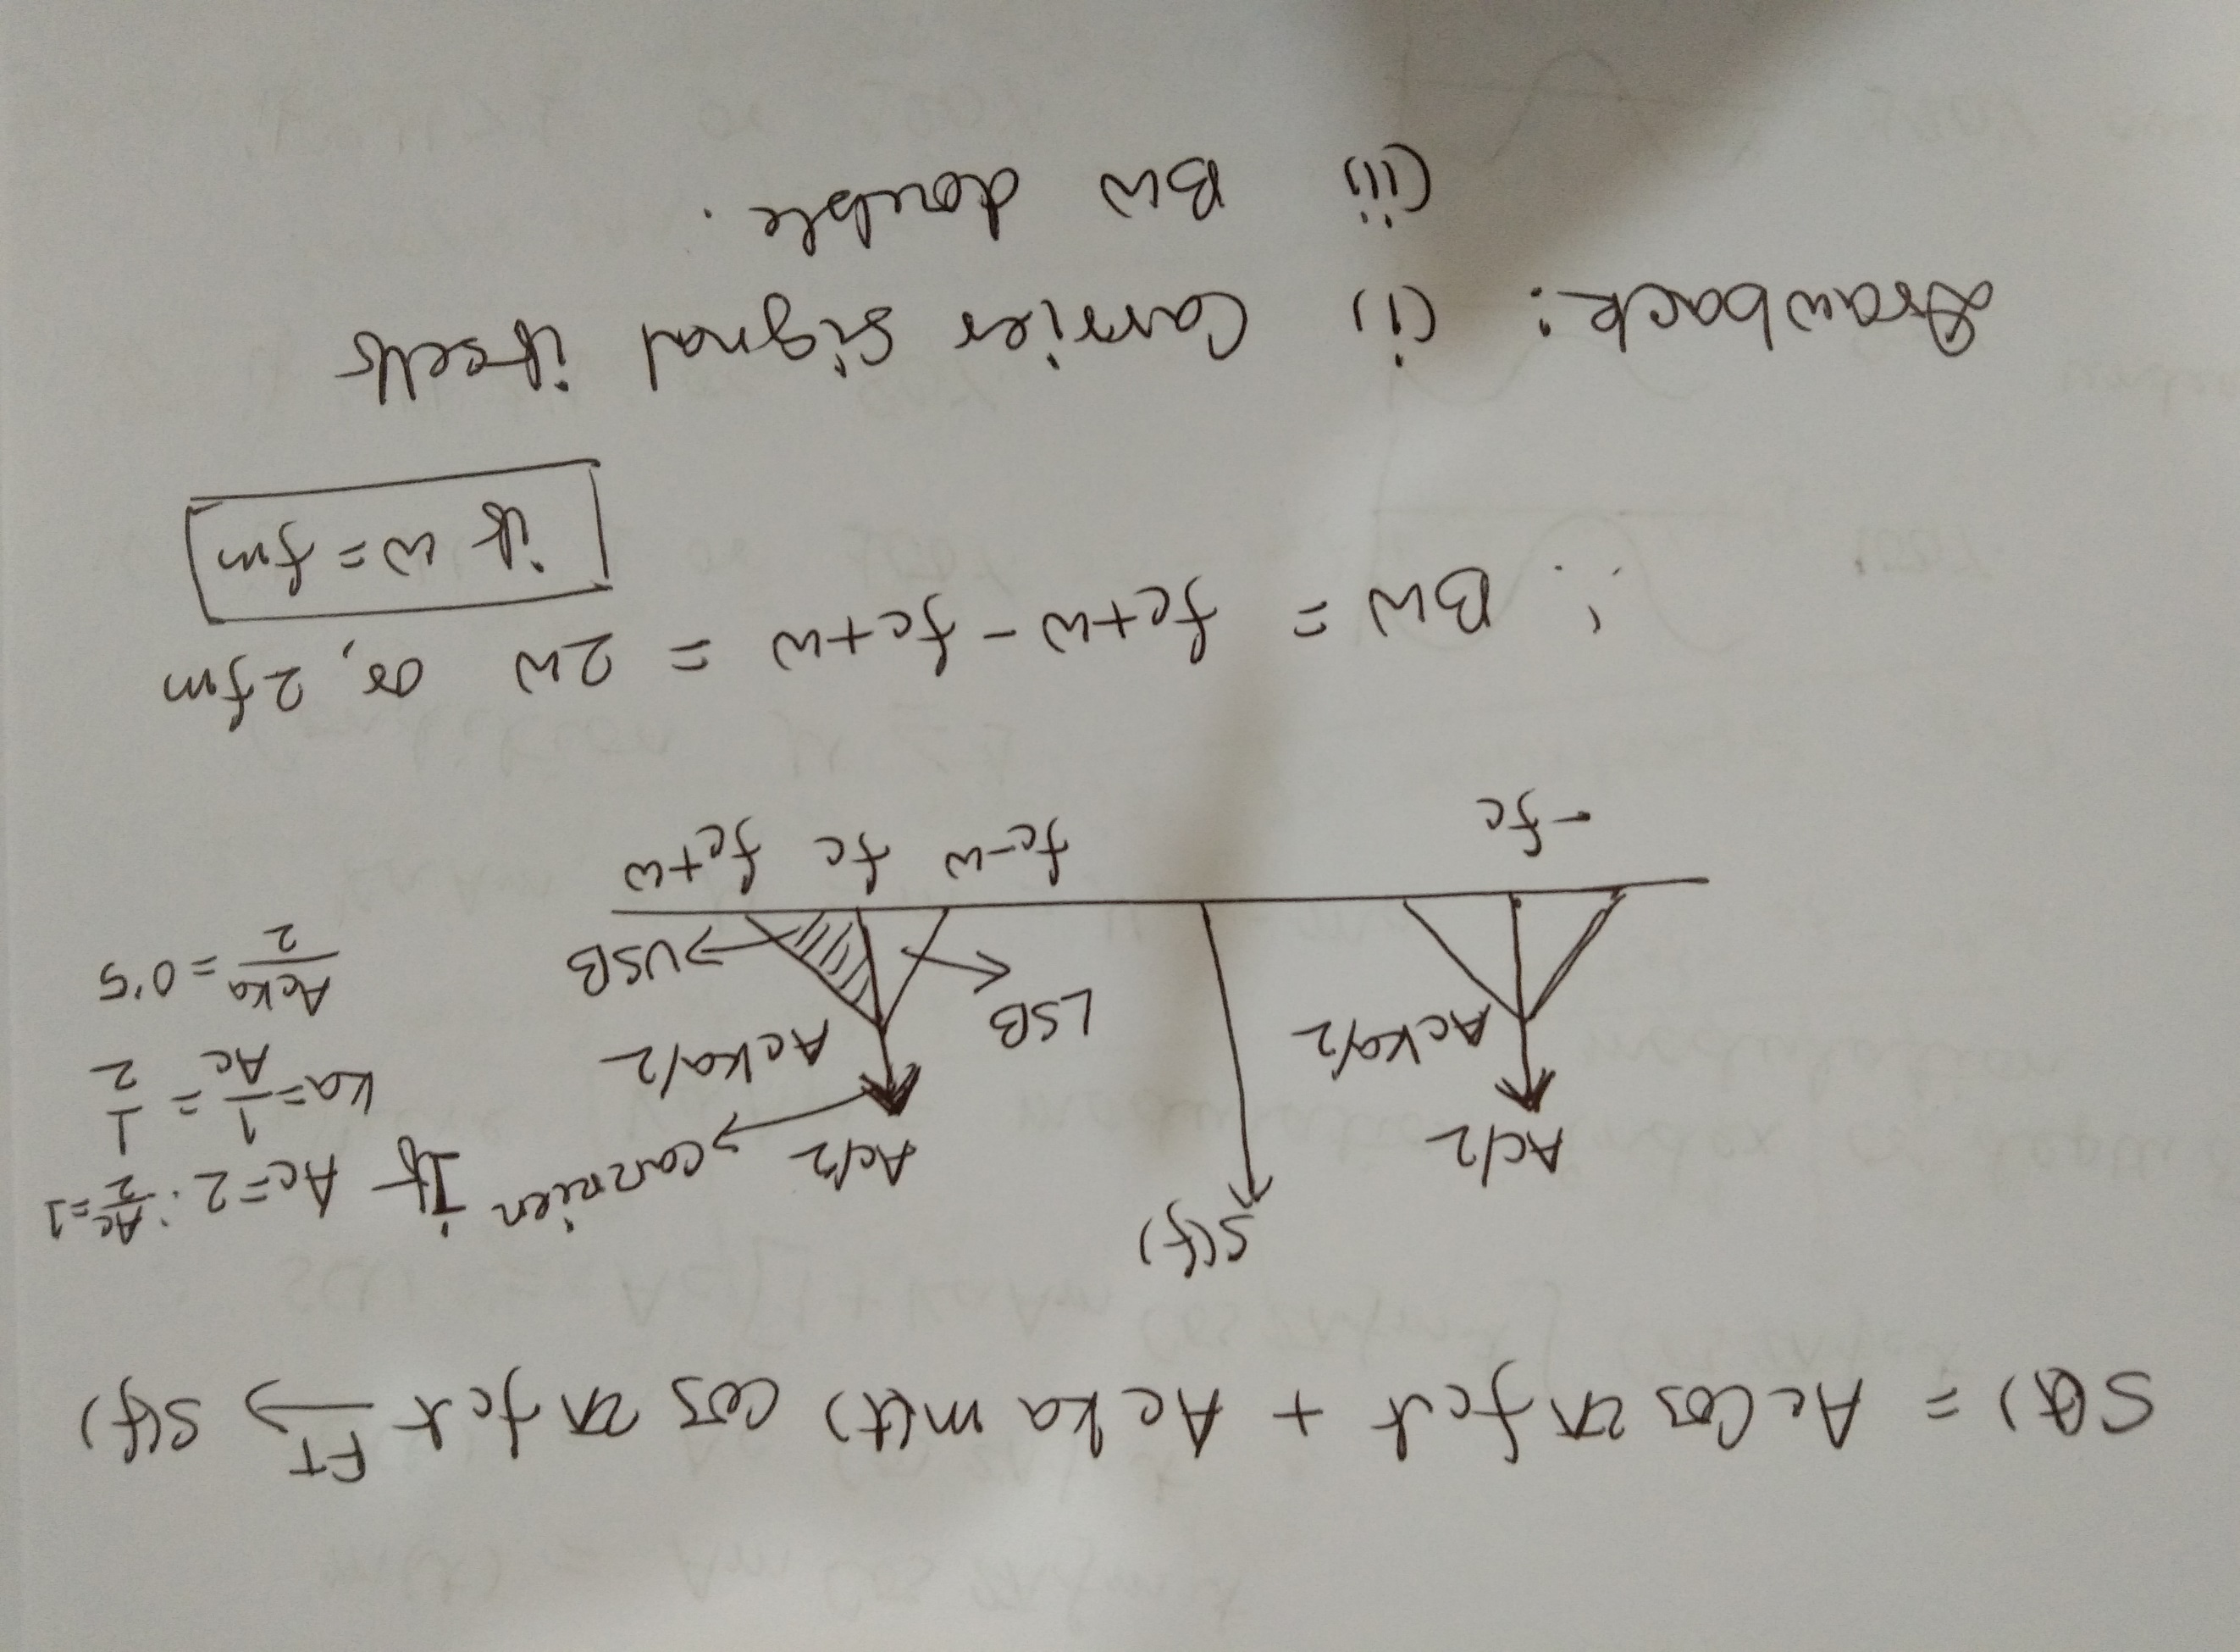

Slide 19
When Baseband signal have single frequency (or single tone signal) and corresponding spectrum of AM signal

Slide 20
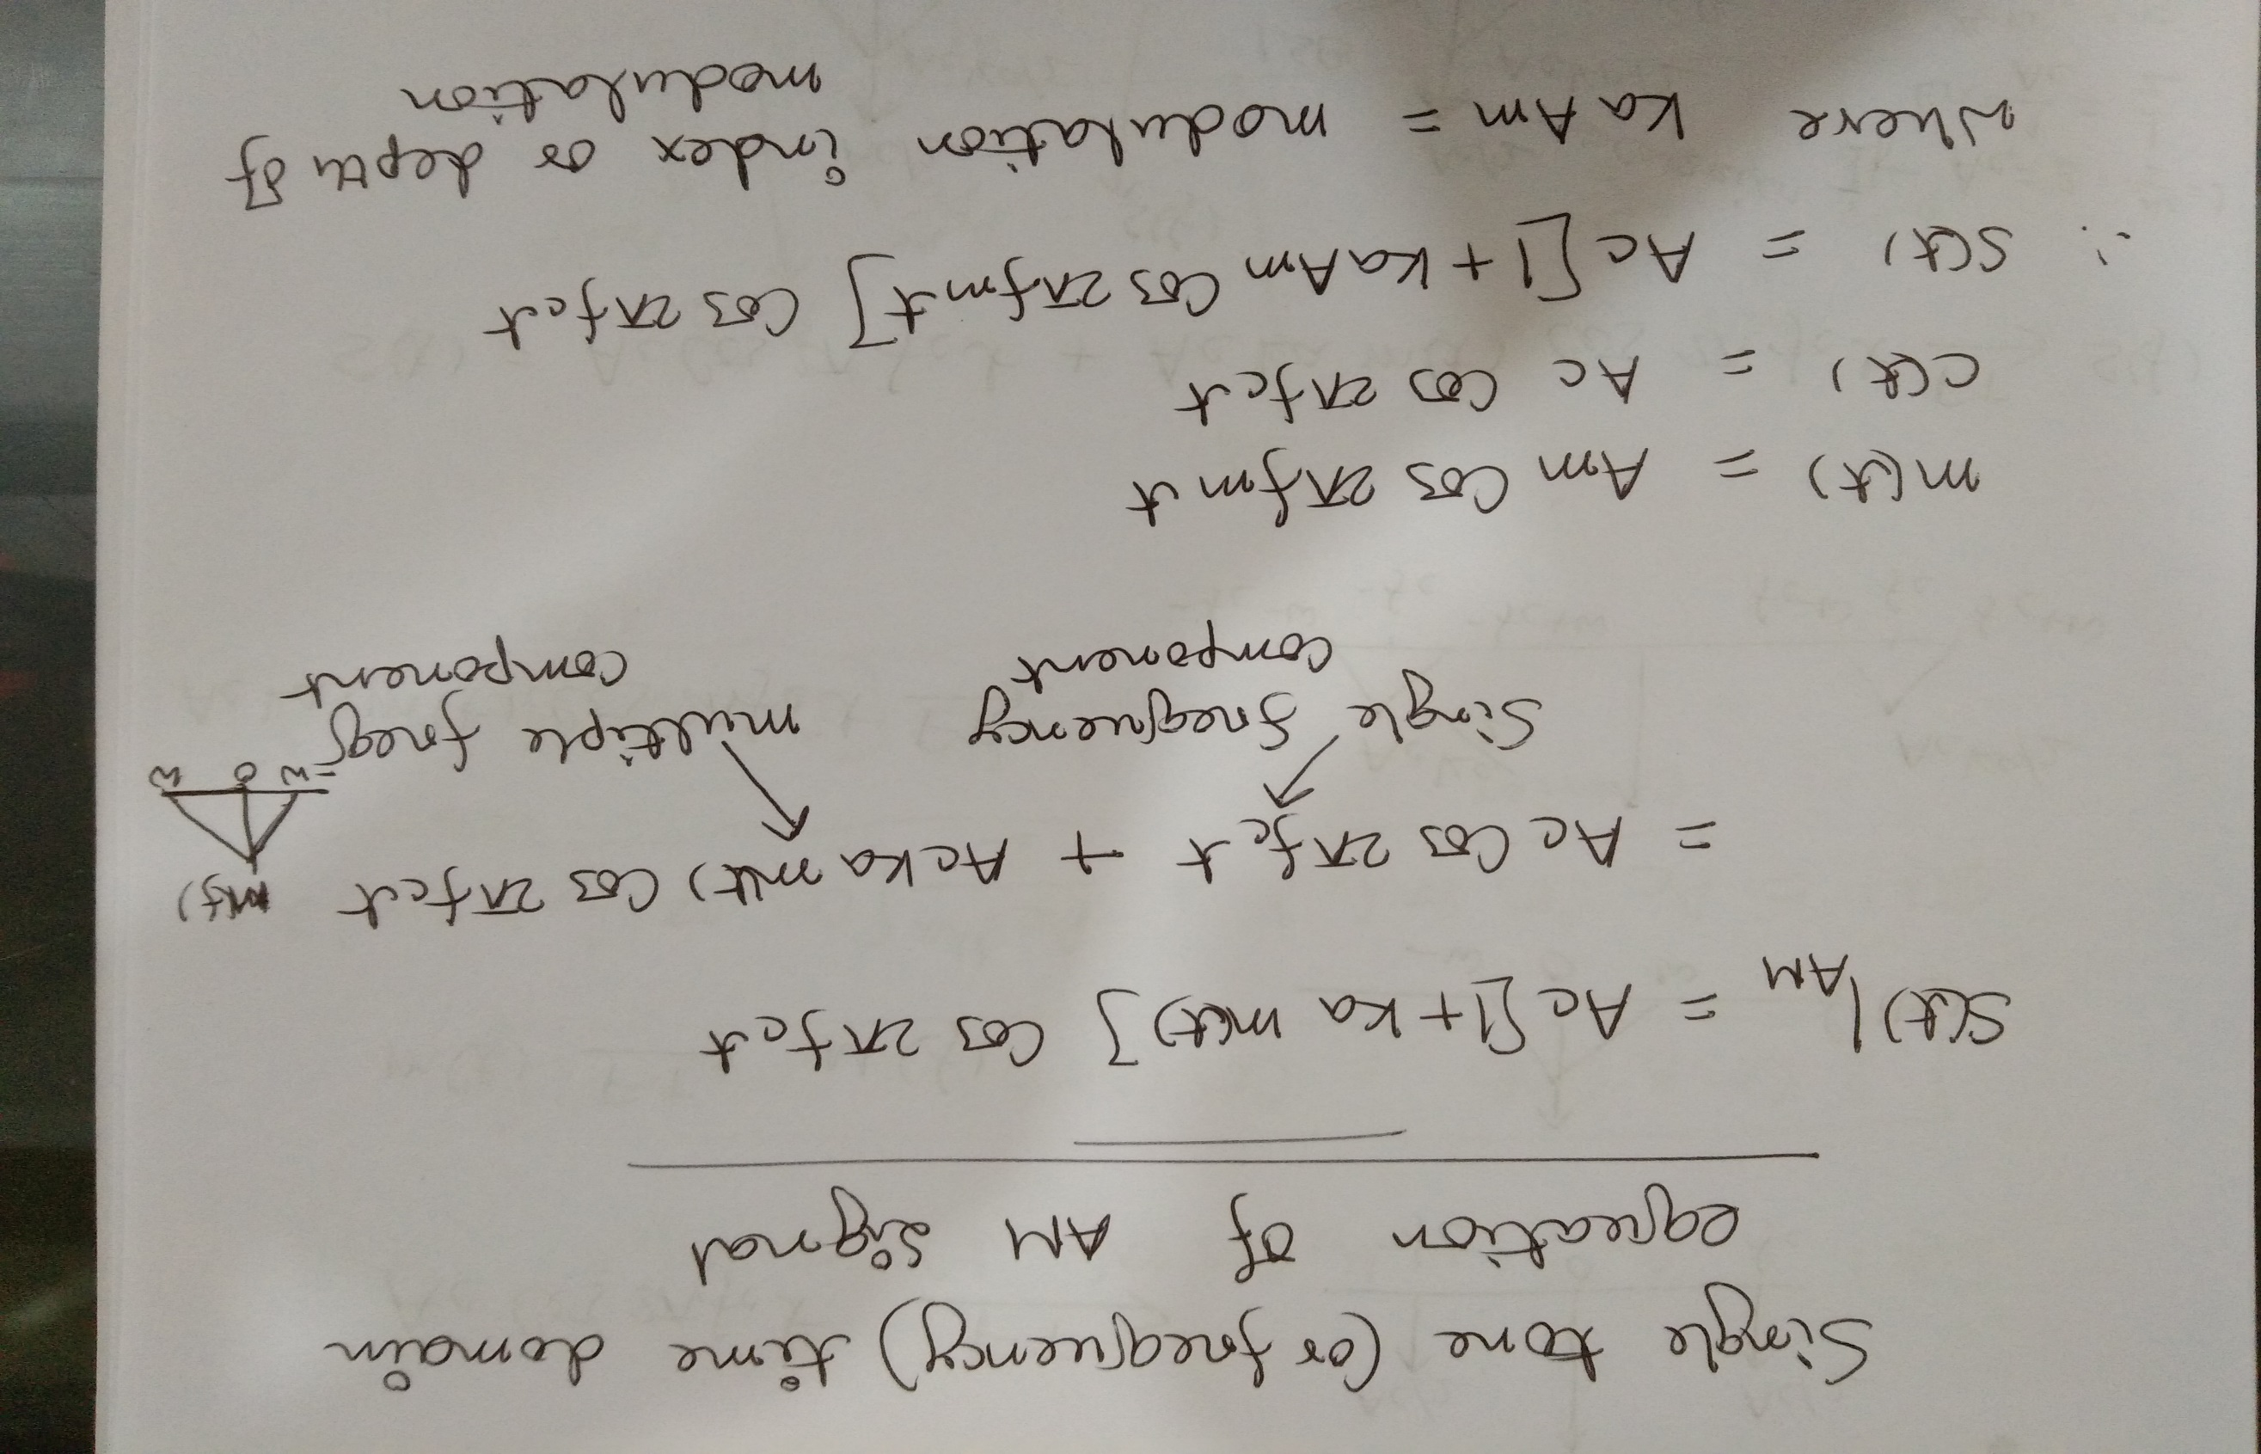

Slide 21
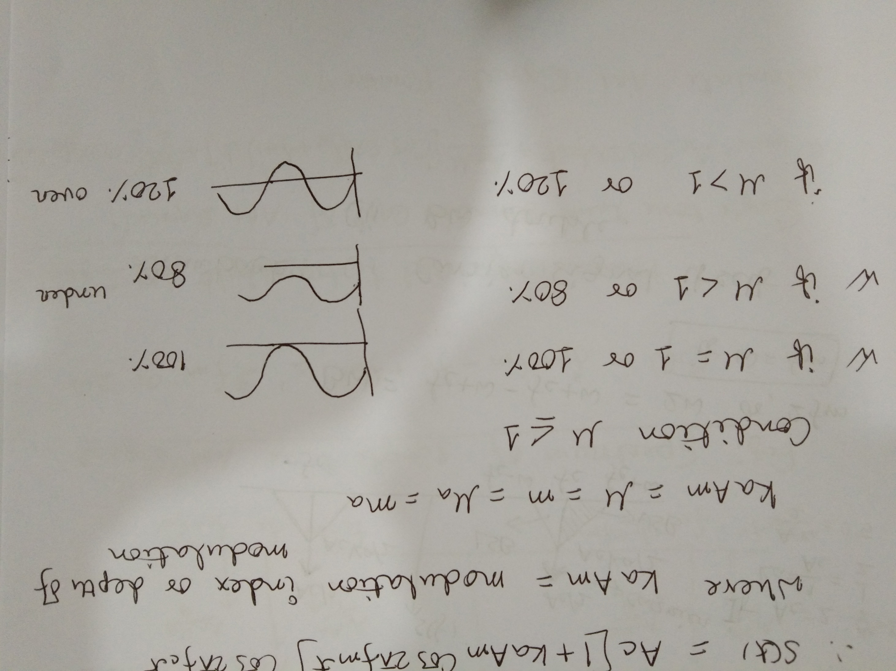

Slide 22
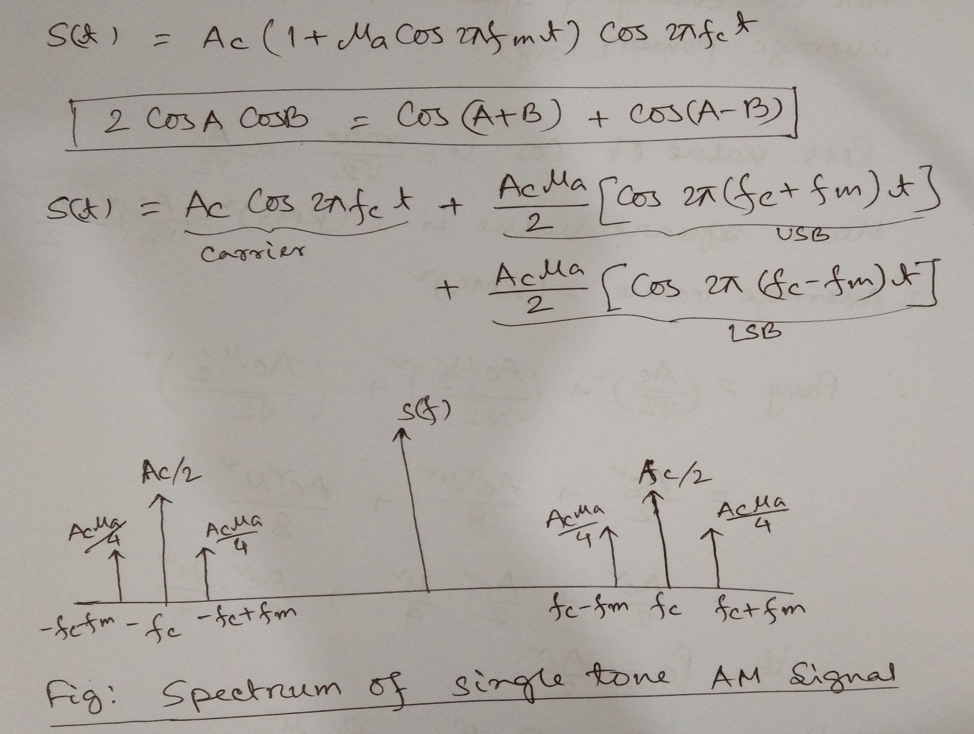

Slide 23
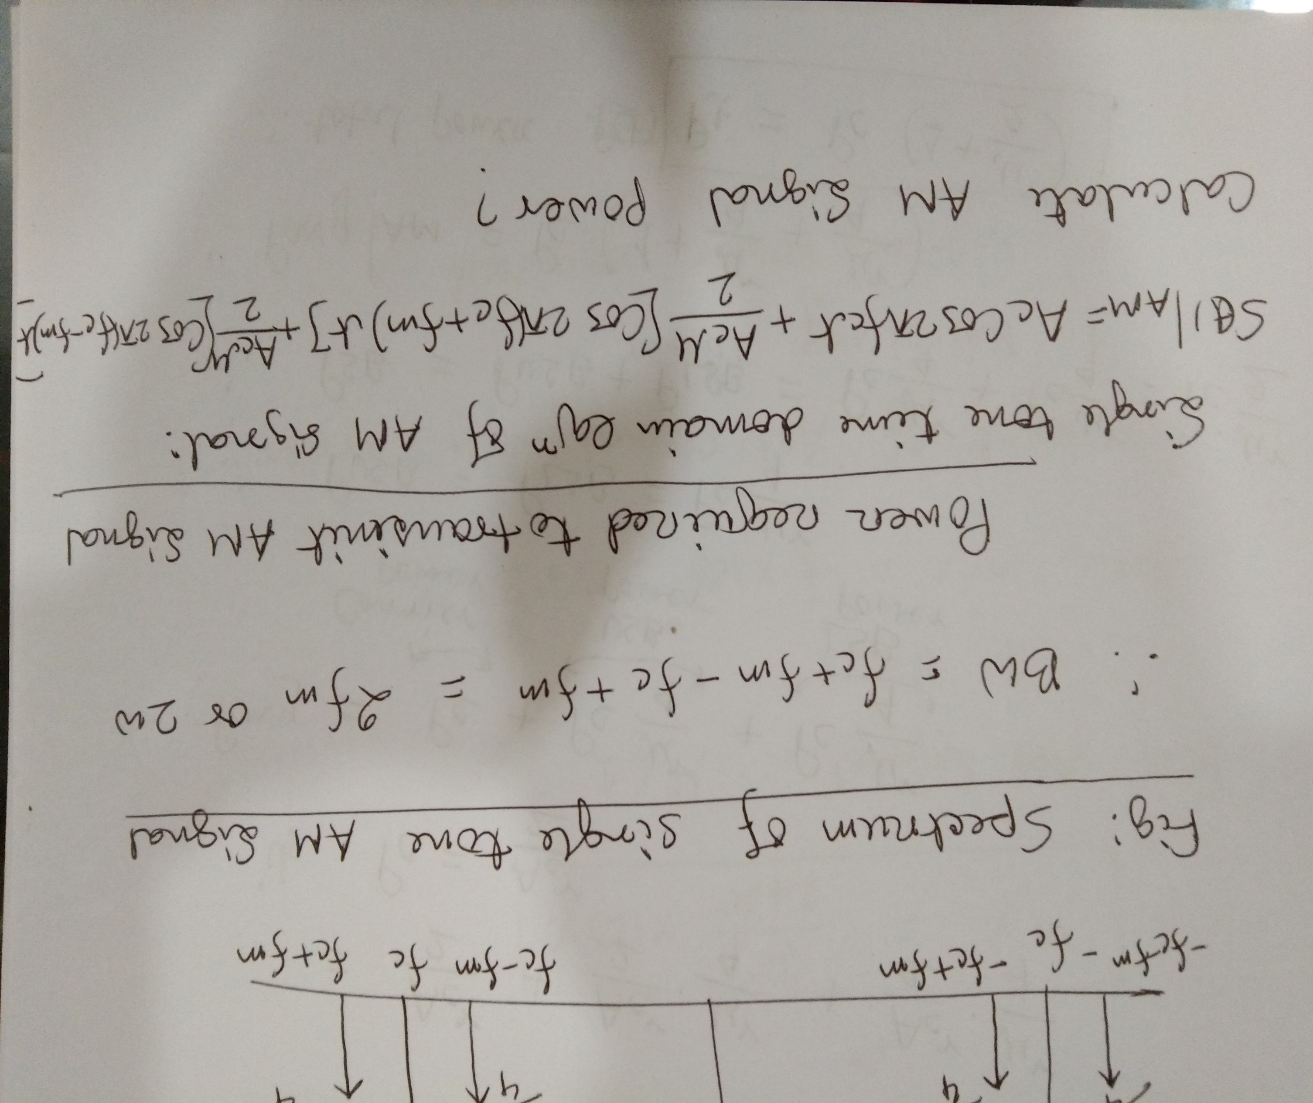

Slide 24
Waveform of AM signal and few important formulae

Slide 25
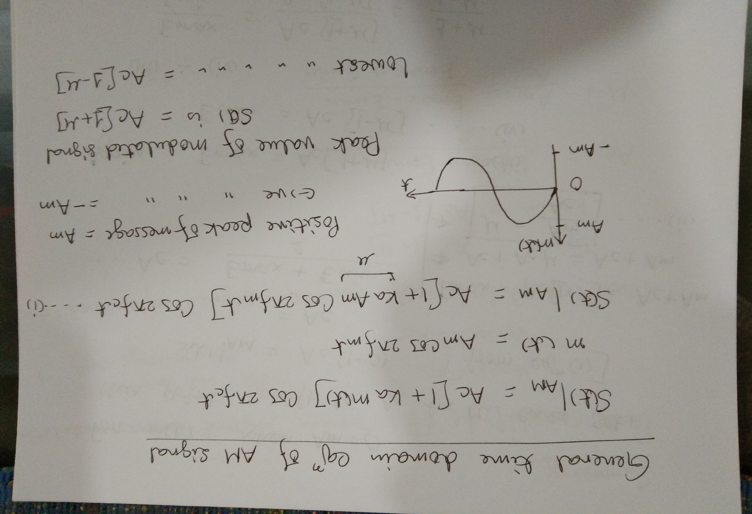

Slide 26
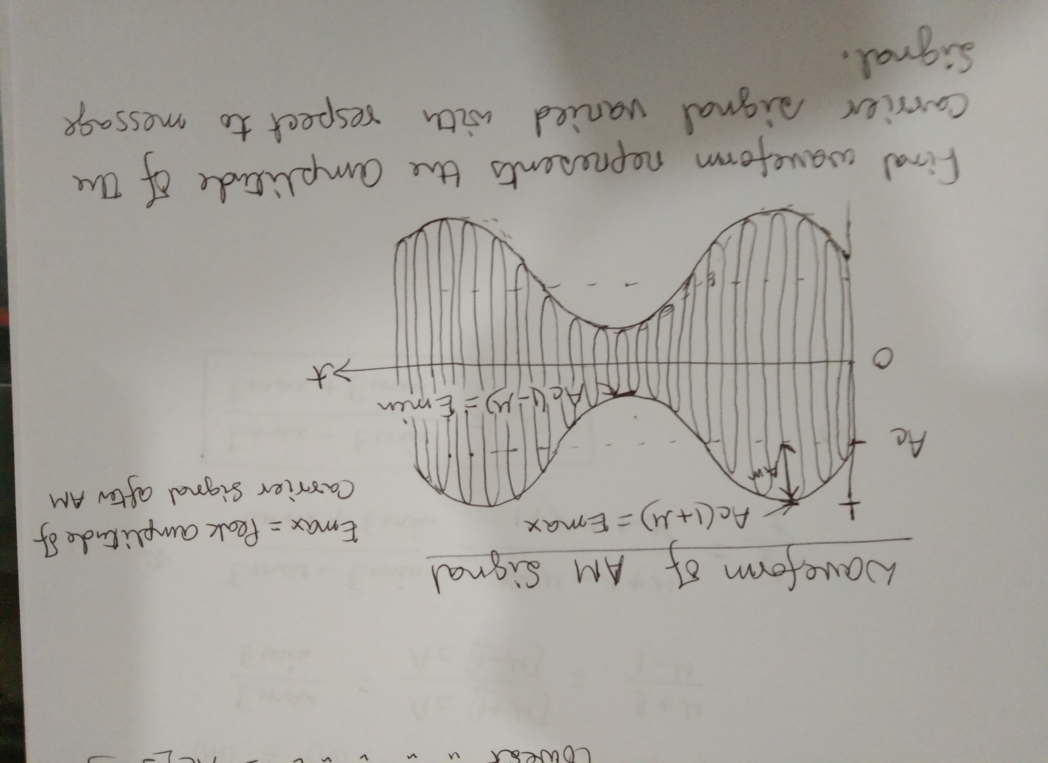

Slide 27
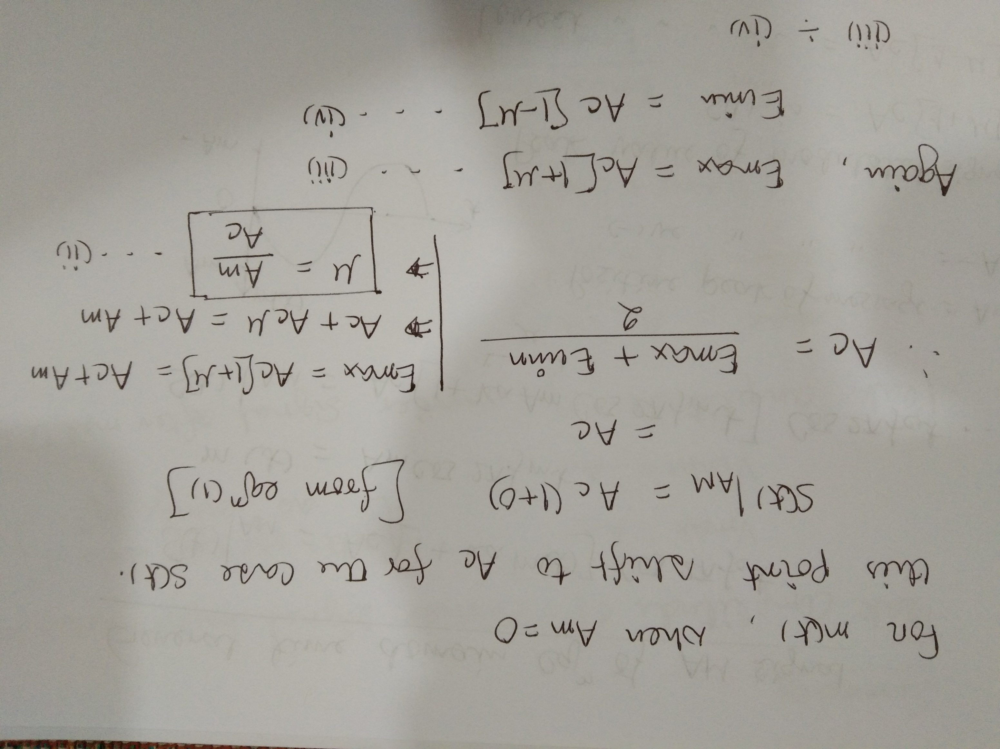

Slide 28
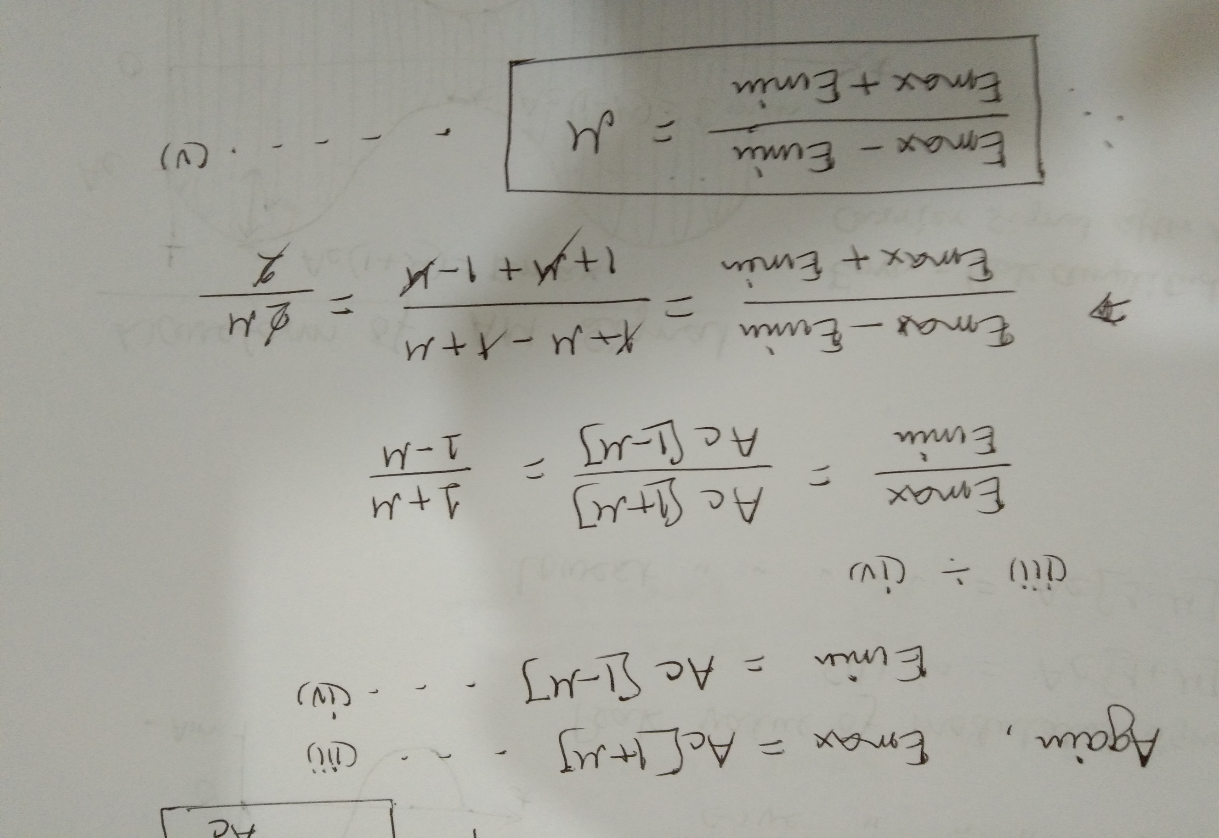

Slide 29
